Slide 1


SaskCanola Research Update Doug Heath December 5, 2023

Slide 2

What does a typical Pre-Breeding Germplasm Development Research Project cost a Farmer?
Notes:
Next, I’d like to talk about the costs and benefits of farmer-driven pre-breeding trait research by running through some “back of the napkin” numbers.

Slide 3

Assumptions:
10,000ac farm with 5,000ac canola each year
Yield: 1tonne/ac
Levy: $0.75/tonne
Price: $700/tonne
Total levy paid $3,750
Total gross revenue
$3,500,000
Notes:
The 5000ac canola is just a round number, so farmers can compare roughly where they would sit in comparison.
And we would hope to see longer rotations so that less than ½ of your acres are in canola.
1 tonne/ac = 44bu/ac
The total levy paid by this farmer on the 5000ac of canola would be $3,750 (on revenues of $3.5M)

Slide 4
SaskCanola annual budget $8,000,000
Average Germplasm Development project $100,000/year
=1.25%
Notes:
SaskCanola’s annual working budget is close to $8M
An average Germplasm research project would typically be about $100,000 of SaskCanola funding per year
(additional funding can be leveraged from other organizations, including provincial and federal gov’ts)
So, this amounts to 1.25% of the total annual budget.

Slide 5
1.25% of the $3,750
=$47 total levy towards this project/year
* 3 years = $141
Notes:
For this farmer, this means that 1.25% of their $3,750 levy that was collected equals $47 towards this research project per year.
And over a 3-year project timeframe, this farmer’s total contribution to the project would be $141

Slide 6
What is Gained every year in future canola varieties?
A new trait that prevents a 5% yield loss:
=0.05tonne/ac
=$175,000/season
Or even with as low as a 1% yield gain:
=0.01 tonne/ac
=$35,000/season on 5000ac
Notes:
Now, there will be a lag in the trait development pipeline before it is available in commercial varieties, so this is also why it is important to keep this pipeline full.
But, once this one trait is captured in a variety, and assuming either a 5% or 1% yield gain (or loss prevention), this one-time investment of $141 could potentially add $175K or $35K just in these simple examples on 5000ac.
0.01 tonne/ac is less than half a bu/ac for the increase of $35,000 for every canola growing season thereafter.
Seed breeding companies definitely invest in trait research and the high costs of bringing new traits into their breeding programs as well.
But farmer investment can leverage government co-funding, and together with non-exclusive licencing, and this means that the best new traits can be brought into many seed breeding programs so that companies can offer the best combinations of genetic traits to farmers while keeping seed costs down.

Slide 7
What is Gained every year in future canola varieties?
A new trait that prevents a 5% yield loss:
=0.05tonne/ac
=$175,000/season
Or even with as low as a 1% yield gain:
=0.01 tonne/ac
=$35,000/season on 5000ac
Notes:
The key point here is that when farmers invest in pre-breeding trait discovery, it eliminates waste and duplication of effort that otherwise would have to be done independently in each of the many canola breeding programs and seed companies.
This buys farmers improved efficiency of trait discovery and access to those traits by multiple breeders so that the major trait combinations needed for tomorrow’s challenges can be had by all breeders.
This also allows commercial breeding programs to focus their efforts on other unique breeding innovations for their own competitive advantage.

Slide 8
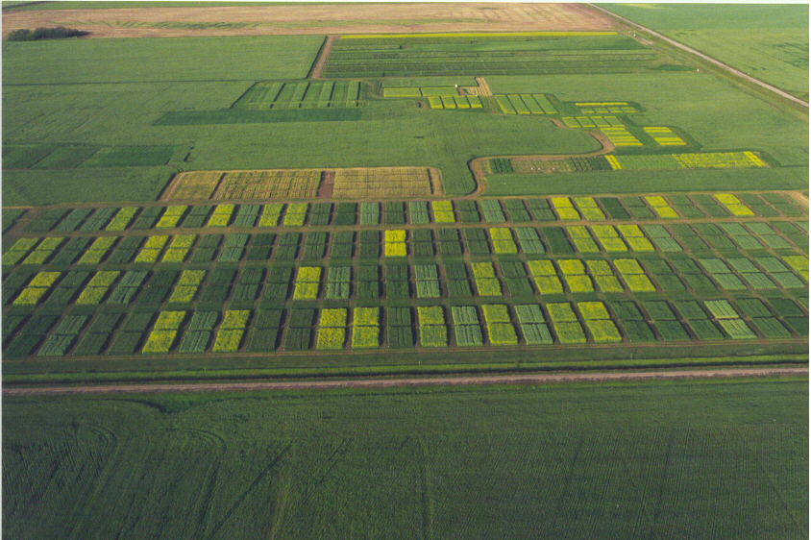
An initial $141 could lead to gains of $35,000/year
Key Takeaways:
Visual diagnosis of Verticillium vs Blackleg on green or pre-harvest stem samples is not always accurate. Therefore, it is crucial to submit samples for molecular diagnosis to ensure a reliable outcome.
Pre-breeding genetics research helps drive the whole seed breeding industry forward at minimal cost to farmers.
Notes:
I hope that my calculations have convinced you of the power of farmers working collectively to drive the industry forward and partnering with governments and other research groups to leverage funding to lead discovery of new traits that can increase or maintain yields against evolving threats in the field.
My goal for today is to keep the conversation going for these 2 issues.
NOTE: Even if a new trait was so good that seed companies raised the cost of a bag of canola by $50 (not realistic), on 500 bags to cover 5000ac, this is still only $25,000 so you are ahead by $10,000/year, every year, for your initial one-time investment of $141.

Slide 9
Thank You!
Notes:
For more information on VS and BL diagnosis, visit SaskCanola.com and the Canola Council of Canada’s Canola Research HUB and Canola Encyclopedia.
I am available to talk about either of these topics and can answer any questions.
Thank-you

